Slide 1
Figure 1-5 Gaps in Care Reporting Scenario
Request $care-gaps Operation
Client
Server
Return DEQM Gaps in Care Bundle(s)

Slide 2
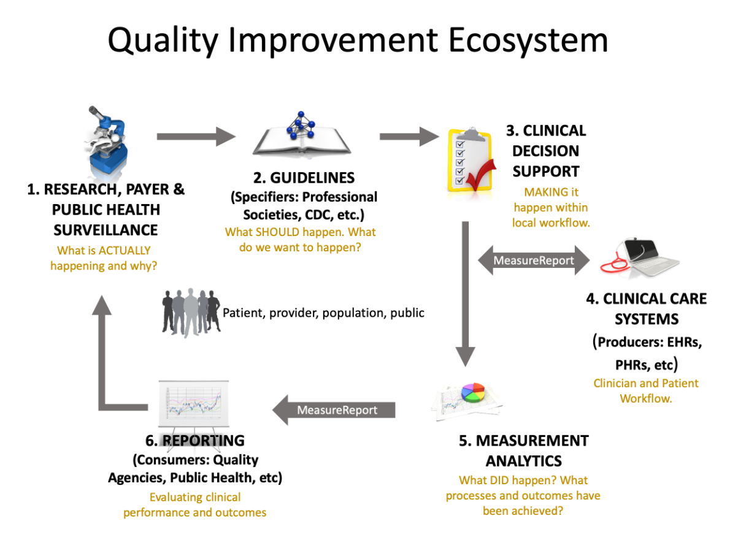

Slide 3


Clinical Care Systems request a report on one or more patient’s Care Gap Information based on Measure(s) criteria
Clinical Care Systems
Measurement Analytics
Provider Workflow
Payer, Reporting Vendor, or internal analytics (etc.) Workflow
Based on the Measure criteria, the Measurement Analytics system, genereeates a report showing open or closed gaps of Patient(s) for that measure

